Slide 1
Bayesian Network Inference and Analysis
Gabrielle Mack
CS 634 Spring 2017
Dr. Jason Wang

Slide 2
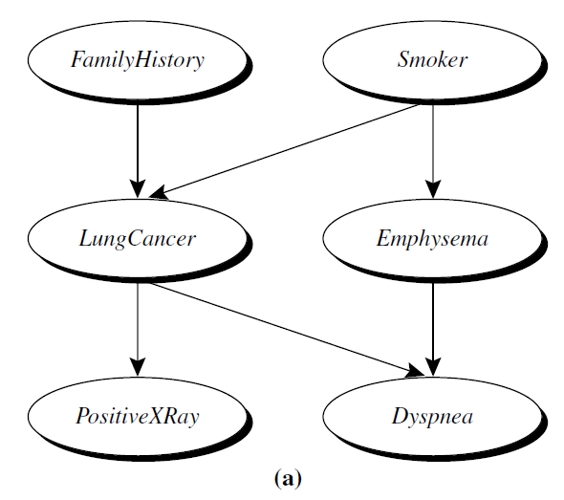
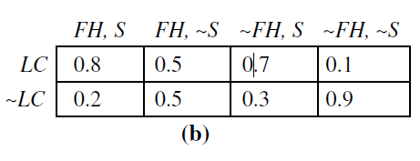
What is a Bayesian Network?
Bayesian networks are a form of machine learning algorithm which utilizes joint conditional probability distributions to perform causal analysis.
They can be referred to as “belief networks” or “probabilistic networks” .
They consist of a directed acyclic graph (DAG) representing variable relationships and associated conditional probability tables.
Changes within the Bayesian network propagate throughout the network with network training.
Directed Acyclic Graph
Conditional Probability Table
Source: “Data Mining Concept and Techniques”, Han, et al

Slide 3
What is a Bayesian Network?
Each node within a Bayesian network represents a variable.
Variables can be either discrete or continuous.
Variables are connected through a series of arcs or arrows indicating a dependence on one another.
The direction of the arc indicates what type of dependence in a parent/descendent order.
Variables are conditionally independent of nondescendents.
Parent
Parent
Dependent
Source: “Data Mining Concept and Techniques”, Han, et al

Slide 4
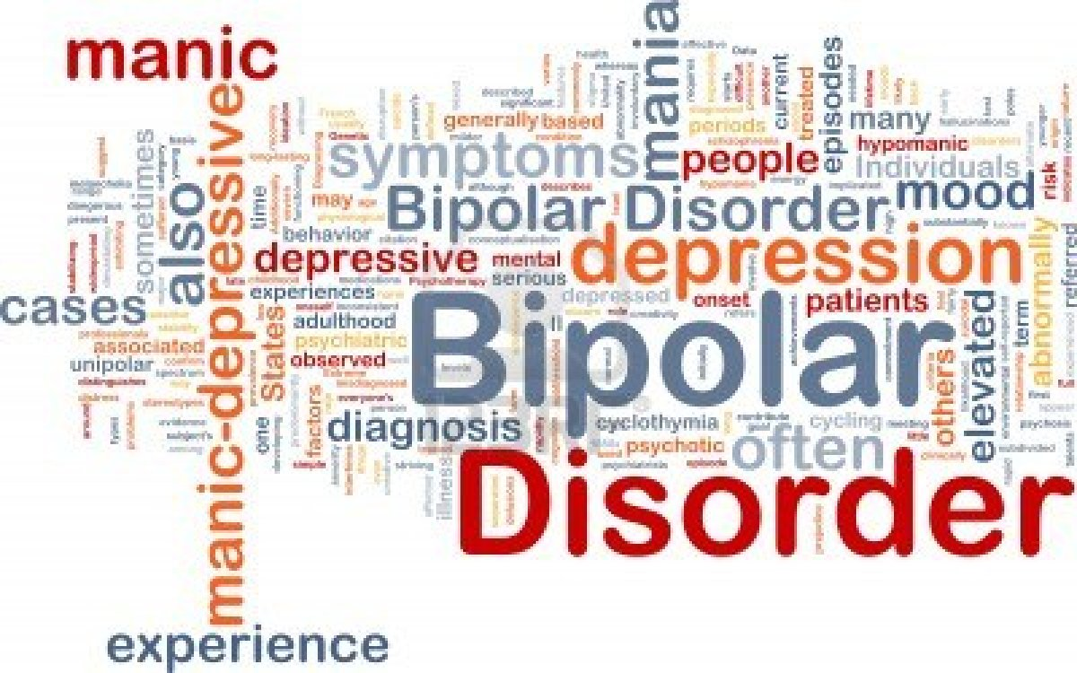
Building Bayesian Networks (An Example)
Suppose we were analyzing the likelihood of a patient developing Bipolar Disorder.
Many different factors or variables can contribute to a patient developing Bipolar Disorder.
Some of these variables include:
Family history
A chemical imbalance of neurotransmitters in the brain
If a patient is diagnosed, they are classified as either Type I or Type II.
Source: Bipolar Disorder Word Cloud, bricefoundation.org

Slide 5
Building Bayesian Networks (An Example)
We start with listing all the variables that can contribute to developing bipolar, in this case, family history, and Neuro-Chemical Imbalance.
Each of these variables has a probability of occurring within a sample size.
For example, in a sample size of 100, lets say 60% of patients have a family history, and 80% of patients have a chemical imbalance.
We list the probabilities for each within a probability table.
Probability of Family History P(H)
T | F
.6 | .4
Family History
(H)
Neuro-Chemical Imbalance
(I)
Probability of Family History P(I)
T | F
.8 | .2

Slide 6
Building Bayesian Networks (An Example)
Next we diagram dependencies for those variables by drawing arcs between those that are conditionally dependent of one another.
In this case, Family History and Neuro-Chemical Imbalance are contributing factors to developing Bipolar Disorder.
Nodes that do not have arcs are said to be conditionally independent of one another, that is, the existence of one does not affect the probability of the other occurring.
Both (H) and (I) are parent nodes of their descendent (B)
Family History
(H)
Neuro-Chemical Imbalance
(I)
Parent Nodes
Bipolar Disorder
(B)
Child/Descendent Node

Slide 7
Building Bayesian Networks (An Example)
We then calculate the conditional probability of the child nodes based on the probabilities of their parents.
P(H)
T | F
.6 | .4
P(I)
T | F
.8 | .2
H | I | P(B)
T | T | .48
T | F | .12
F | T | .32
F | F | .08
Family History
(H)
Neuro-Chemical Imbalance
(I)
Bipolar Disorder
(B)

Slide 8
Building Bayesian Networks (An Example)
We continue this process for subsequent child nodes of each parent.
In this case, if a patient is diagnosed Bi-Polar, they can be one of two types.
Family History
(H)
Neuro-Chemical Imbalance
(I)
Bipolar Disorder
(B)
Parent Node
Child/Descendent Node
Type I
(Y1)
Type II
(YII)

Slide 9
Probability in Bayesian Networks
P(H), P(I)
P(B | H,I)
P(Y1 | B)
P(YII | B)
P(H), P(I)
P(B | H,I)
P(Y1 | B)
P(YII | B)
Family History
(H)
Neuro-Chemical Imbalance
(I)
Bipolar Disorder
(B)
Type I
(Y1)
Type II
(YII)

Slide 10
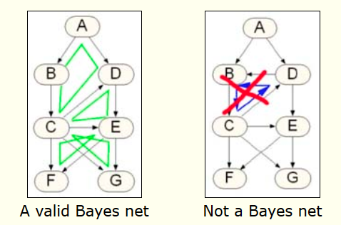
Loops and Cycles
Loops between nodes are permitted as they do not form logical infinite loops.
Infinite loops between nodes are known as cycles and are generally not allowed in order to be considered a valid Bayesian Network.
Some software packages allow the user to ignore this particular require. (IE, one can set ignore.cycles to TRUE.
Source: Netica Tutorials (norsys.com)

Slide 11
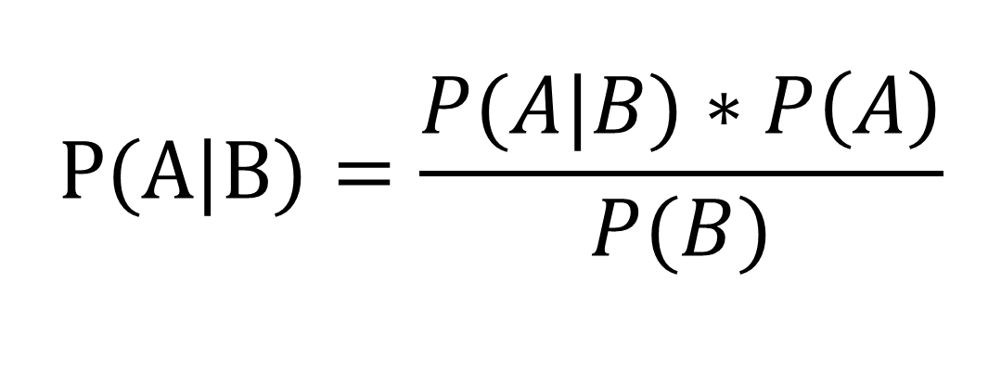
Bayes Rule
Using Bayes rule was can calculate the joint probability of a hypothesis
Prior: The prior probability of the hypothesis given the evidence that has already been established
Likelihood is the probability given the hypothesis
Marginal Likelihood is the probability of evidence.
Likelihood
Prior
$$P(A|B)=\frac{P(A|B)∗P\left(A\right)}{P(B)}$$
Posterior
Marginal Likelihood

Slide 12
Bayesian Network Uses
Bayesian networks are used for causal inference, or educated guesses of the probability of an outcome, given the evidence we have.
This can be used to predict cause and effect results in virtually every industry.
Almost all Artificial Intelligence utilizes some type of Bayesian network or Bayesian Inference for decision making.
Artificial Intelligence can not completely emulate the human brain because humans psychologically experience cognitive dissonance.
Cognitive dissonance is continuing to support a belief (node) despite being given overwhelming evidence that the belief is false. (Node no longer effects the entire network)
In a Bayesian network, a network node link would be removed if found to be irrelevant to the network, therefore no longer effecting the performance of the network.
Cognitive dissonance in humans results in these ‘orphaned nodes’ continuing to effect our belief systems or networks.

Slide 13
Bayesian Network Uses
Networks can be used by multiple industries for causal analysis:
Insurance companies can use Bayesian networks to predict the likelihood of insurance claims given a list of conditions.
Financial institutions can use Bayesian networks to predict investment performance.
Health care providers can also make educated decisions based on evidence of prior symptoms and probability distributions of patients experiencing them.

Slide 14
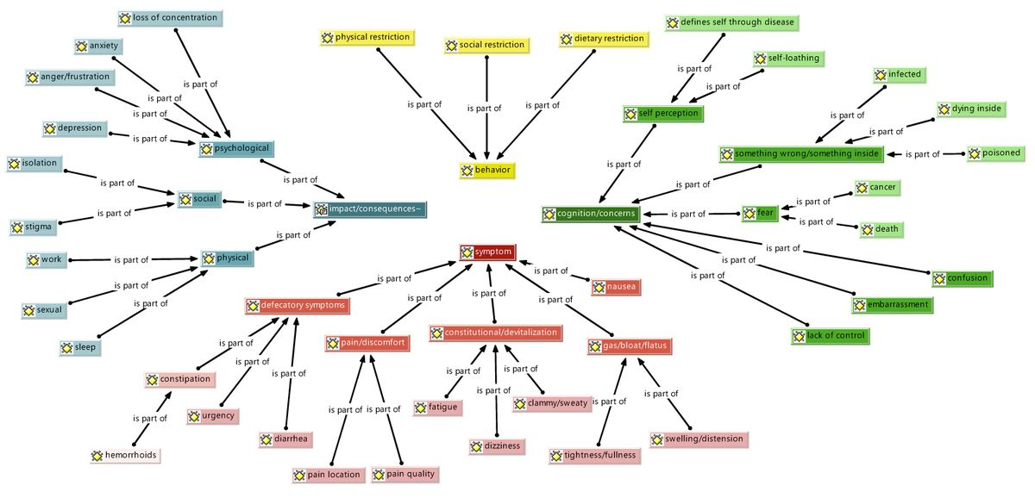
Bayesian Networks for Causal Discovery
Source: “Diverticulitis patients reveal psychological and physical symptoms long after acute attacks”, UCLA

Slide 15
Bayesian Networks for Causal Discovery
Causal discovery has many applications in the field of medicine in which inference can be made given the appropriate amount of data is provided to a Bayesian Network.
A research team decided to build a complicated Bayesian Network tool to assist mental healthcare providers in researching signs and symptoms for patients.
The resulting network allows Healthcare providers with a working information system that can establish a causal relationship between apparent symptoms and mental illnesses.
Source: “Diverticulitis patients reveal psychological and physical symptoms long after acute attacks”, UCLA

Slide 16
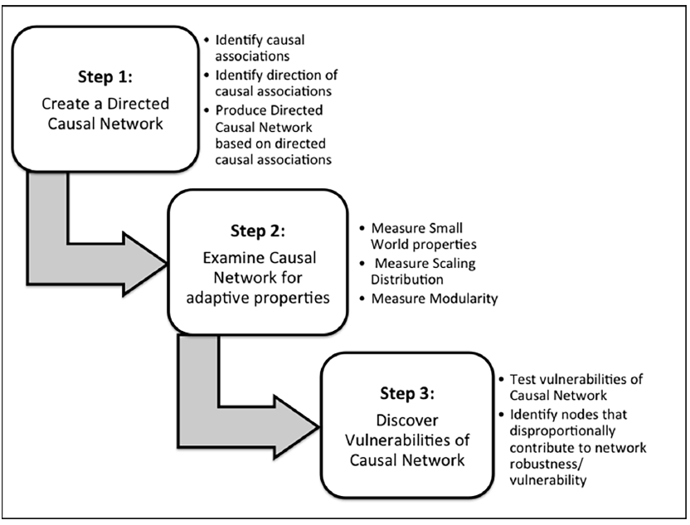
Complex Systems – Causal Network (CS-CN)
The team of researchers developed the network and tested it upon 3 different datasets and found that the network had reliable results amongst all three tests.
A total of 962 nodes and 5126 links were produced by the network.
The network was trained multiple times using test and training datasets.
The network was applied to production data producing valuable results for mental health care providers.
Source: “A Complex Systems Approach to Causal Discovery in Psychiatry”, Saxe et Al, PLoS One

Slide 17
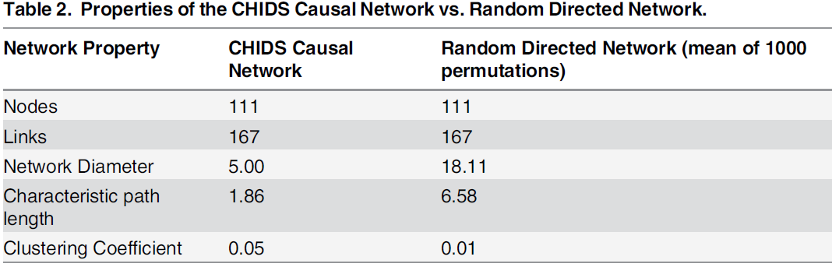
Complex Systems – Causal Network (CS-CN)
Source: “A Complex Systems Approach to Causal Discovery in Psychiatry”, Saxe et Al, PLoS One

Slide 18
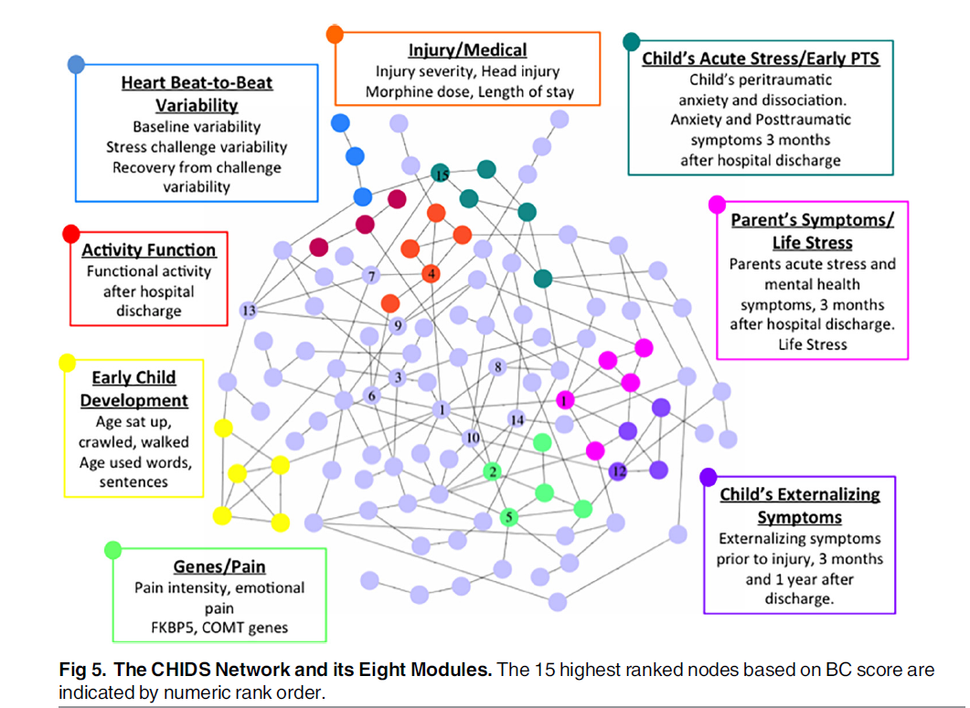
Complex Systems – Causal Network (CS-CN)
The team chose the top 8 most frequent variable groupings to focus their research on, though, other variables and groupings can be added by additional researchers.
The resulting node map illustrated each relationship per variable grouping that would eventually propagate throughout their network.
Source: “A Complex Systems Approach to Causal Discovery in Psychiatry”, Saxe et Al, PLoS One

Slide 19
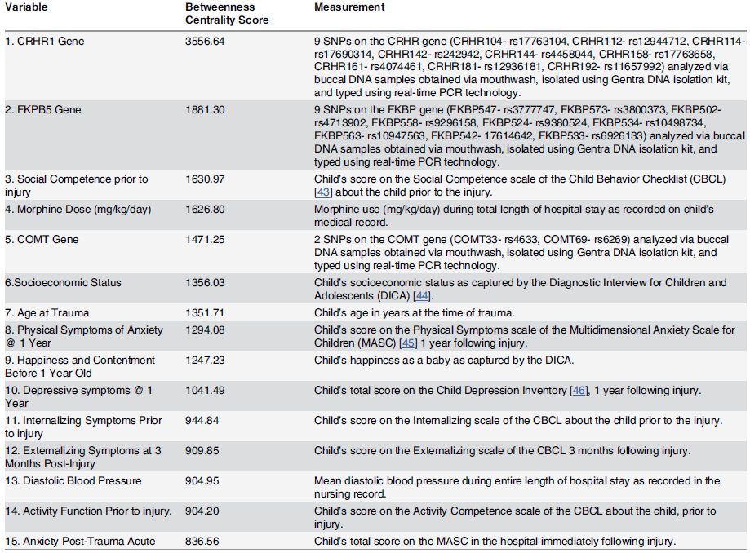
Complex Systems – Causal Network (CS-CN)
Source: “A Complex Systems Approach to Causal Discovery in Psychiatry”, Saxe et Al, PLoS One

Slide 20
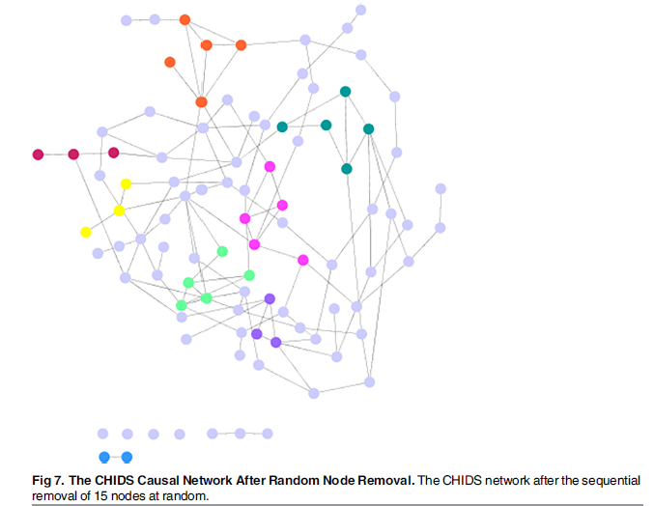
Complex Systems – Causal Network (CS-CN)
The team also performed systemic removal of nodes to investigate the effect each node had on its predecessor.
15 nodes were chosen at random to be removed.
They found that the system was highly adaptive until the 4 most prevalent nodes were removed.
Likewise, the team discovered that additional nodes improved the performance of the system, if such nodes were linked to the 4 major nodes.
Source: “A Complex Systems Approach to Causal Discovery in Psychiatry”, Saxe et Al, PLoS One

Slide 21
Bayesian Network Tools
A variety of tools are available for Bayesian Network Analysis:
MATLab – Bayes Net Toolbox (BNT) is an extension used to create Bayesian Networks in MATLab
BayesServer – Software that allows users to build a Bayesian network through a graphical interface.
BayesiaLab – Workflow software similar to BayesServer.
JavaBayes – Java API for utilizing Bayesian Networks.

Slide 22
References
Bayesian Network Structure Learning Using Causality, Zhen XU, University of Buffalo
Bayesian Networks Without Tears, Eugene Charniak, AI Magazine vol 12
Bayes Nets For Representing And Reasoning About Uncertainty, Andrew Moore, Carnegie Mellon University
“A Complex Systems Approach to Causal Discovery in Psychiatry”, Saxe et Al, PLoS One

Slide 23
Questions?

